Slide 1

Customer purchase analysis based on KNN (k- nearest neighbours) algorithm using python.

Slide 2
Abstract
Due to today’s transition from visiting physical stores to online shopping, predicting customer behaviour in the context of e-commerce is gaining importance. It can increase customer satisfaction and sales, resulting in higher conversion rates and a competitive advantage, by facilitating a more personalized shopping process. By utilizing clickstream and supplementary customer data, models for predicting customer behaviour can be built. This study analyses machine learning models to predict a purchase, which is a relevant use case as applied by a large clothing retailer. The results indicate that a k nearest neighbour is best suited for the prediction task, showing the best performance results, reasonable latency, of fering comprehensibility and a high robustness. Regarding the different data types, models trained on sequential session data outperformed models trained on the static customer data by far. The best results were obtained when combining both datasets.

Slide 3
Introduction
Compared with traditional marketing methods, precision marketing has two advantages: one is accuracy. General precision marketing activities are based on mining and analyzing consumer big data, so they can ensure the accuracy of marketing. Second, real-time E-commerce enterprises can observe the changes of consumer preferences in real time and adjust the marketing plan under this premise and accurately push marketing messages related to products for users. Marketing activities can greatly improve the response speed to users’ subjective and non determined factors. is requires accurate prediction and control of the prices of e-commerce products and then recommend products with different prices to consumers according to their acceptance of the prices of products

Slide 4
Problem Identification
Categorizing whether a web shop session will end in a purchase or not, is a relevant use case in the context of predictions in e-commerce. This categorization followed by the display of gift cards to non purchasing customers, to convince them of a purchase nonetheless, has proven to increase turnover of a large German clothing retailer. A variety of possible prediction models as well as different data sources exist to carry out such predictions. This paper aims at retrieving well-suited pre diction models and comparing their performances across different data types, such as static and dynamic data, to establish how customers can be best classified as buying or no buying

Slide 5
Project Outlook
Product catalog
Showing accurate information on the product of any e-commerce.
Suggestions
We can suggest good product in certain price range with good accuracy
Navigators
We are having navigators to suggest best products to the customer
Cart
Cart is also provides data collection for improving accuracy

Slide 6
Project repository
Project source code and data
https://github.com/Chandana-0711/Customer-Purchase-Analysis-based-on-KNN

Slide 7
Design and User Experience
Design
Home page: Collection of data from customer
Navigation: It show the preferred product for particular customer Cart: Shows the customer selection of the product
User Experience
User can get the best suggestion with accurate time and product
he’s interested in

Slide 8
Technical Implementations
Python
Structure of the website and home page and other navigators
Data mining
Used to collect data, pre-processing and integration
K-NN
This algorithm is enhanced to restrict some validations using Euclidean distance formula

Slide 9
Performance and Optimization
Performance
Accuracy of suggestion will be increased to appropriate users respectively
Optimization
Data training and data collecton to improve suggestion to the customer

Slide 10
Results
The obtained results indicate that the KNN performed best while showing reason able prediction latency. Regarding the comprehensibility, no difference between the different algorithms was observed. The performance of different datasets shows that a combined dataset leads to the best results, where customer information enhances the results only slightly.

Slide 11
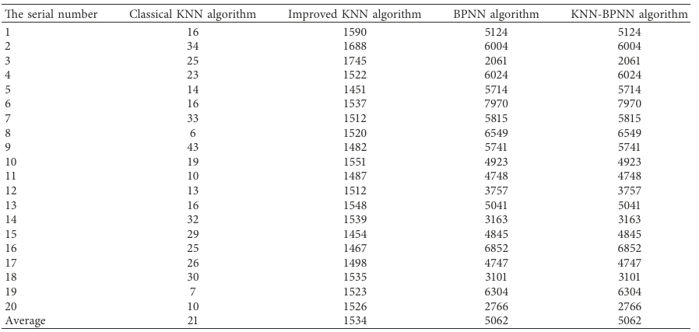


Slide 12
Conclusion
This paper studies the prediction inconsistency of the quantitative range of the model and uses the data mining algorithm to establish the e-commerce agricultural product price and purchase intention prediction model with high prediction accuracy, strong prediction stability, and low computational complexity. In the network environment, marketing means are diverse, and marketing forms are gathered. Specific marketing methods will have a significant impact on the compromise effect, and the compromise effect shown in consumers’ purchase decisions needs to be further studied in detail.
Secondly, for the alternative commodity set, whether the price difference between extreme options and discount options and the discount intensity in the price strategy will also affect the discount effect.

Slide 13
Reference
Detection and prevention of jellyfish attacks using knn-algorithm and trusted routing scheme in manet
Heartbeat classification based on multi-feature combination and stacking dwknn algorithm
Knn-based ap proximate outlier detection algorithm over iot streaming data
Research on traffic situation analysis for urban road network through spatiotemporal data mining: a case study of Xi’an, China

Slide 14
Q&A
Purpose of Customer analysis?
To analysis the behaviour of customer and purchase.
How Suggestion for the product is made?
There will be data collection from mining technique and used to suggest the optimised product.

Slide 15
THE END

